Slide 1
Fake News Project

Slide 2
ABOUT FAKE NEWS
Fake news is false or misleading information presented as news. It often has the aim of damaging the reputation of a person or entity, or making money through advertising revenue. However, the term does not have a fixed definition, and has been applied more broadly to include any type of false information, including unintentional and unconscious mechanisms, and also by high-profile individuals to apply to any news unfavorable to his/her personal perspectives.

Slide 3
PROBLEM STATEMENT
The prevalence of fake news has increased with the rise of social media, Political polarization, post-truth politics, confirmation bias, and social media algorithms have been implicated in the spread of fake news. It is sometimes generated and propagated by hostile foreign actors, particularly during elections. The use of anonymously-hosted fake news websites has made it difficult to prosecute sources of fake news for libel. In some definitions, fake news includes satirical articles misinterpreted as genuine, and articles that employ sensationalist or clickbait headlines that are not supported in the text.

Slide 4
CONCEPTUAL BACKGROUND OF THE DOMAIN PROBLEM
The authenticity of Information has become a longstanding issue affecting businesses and society, both for printed and digital media. On social networks, the reach and effects of information spread occur at such a fast pace and so amplified that distorted, inaccurate, or false information acquires a tremendous potential to cause real-world impacts, within minutes, for millions of users. Recently, several public concerns about this problem and some approaches to mitigate the problem were expressed
In the below blog we are going to see about how we are classifying the fake news with the genuine news; we are going to use several machine learning techniques and we will plot and analyse how to identify a news as fake. I have tried using several NLP techniques and arrived at a model that will classify news is fake or genuine.

Slide 5
Review of Literature
The purpose of the literature review is to:
Identify the News basis on the content and author to tell weather it is fake or not.
Stop the spread of fake news which will potentially spread incorrect information amount the people.

Slide 6
Data Pre Processing
Convert the text to lowercase
Remove the punctuations, digits and special characters
Tokenize the text, filter out the adjectives used in the review and create a new column in data frame
Remove the stop words
Stemming and Lemmatising
Applying Text Vectorization to convert text into numeric

Slide 7
Word Cloud
Word Cloud is a visualization technique for text data wherein each word is picturized with its importance in the context or its frequency.
The more commonly the term appears within the text being analysed, the larger the word appears in the image generated.
The enlarged texts are the greatest number of words used there and small texts are the smaller number of words used.

Slide 8
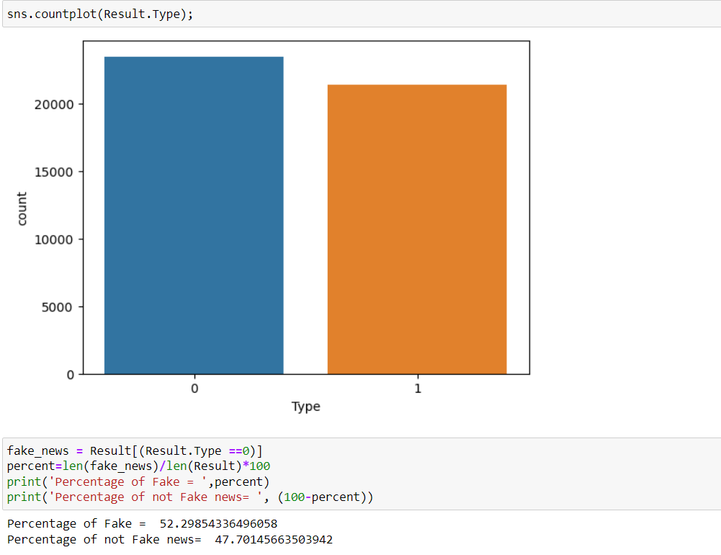
Mathematical Analytical Modeling of the Problem
On further analysis of the label data, I understood that we have a data almost 52.29% of data with fake news and 47.70 of data with not fake news. Balance data will help us in building a perfect machine learning model and we also avoid the model to overfit and underfit with the data.

Slide 9
DATA SOURCE AND FORMATS
There are 6 columns in the dataset. The description of each of the column is given below:
“title”: It is the title of the news.
“text”: It contains the full text of the news article
“subject”: It contain the topic is politics New and politics.
“data”: It is a serial data
“Type”: It tells whether the news is fake (0) or not fake (1)

Slide 10
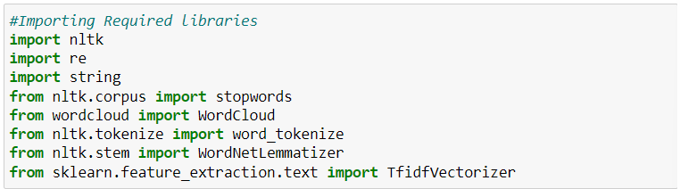
DATA PRE-PROCESSING
I started the pre-processing with cleansing the data, filtering out all the Bash data and I like to keep only the required data for our analysis.
I started with importing the required libraries. And I have declared stop words and lemmatize to a variable

Slide 11
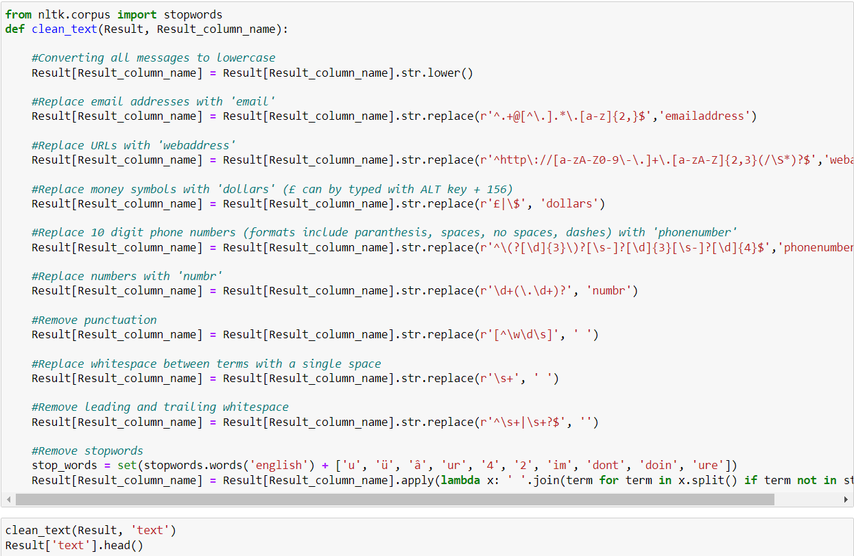
DATA PRE-PROCESSING
After importing all the required libraries, I have defined stopwords and lemmatize to a variable.

Slide 12
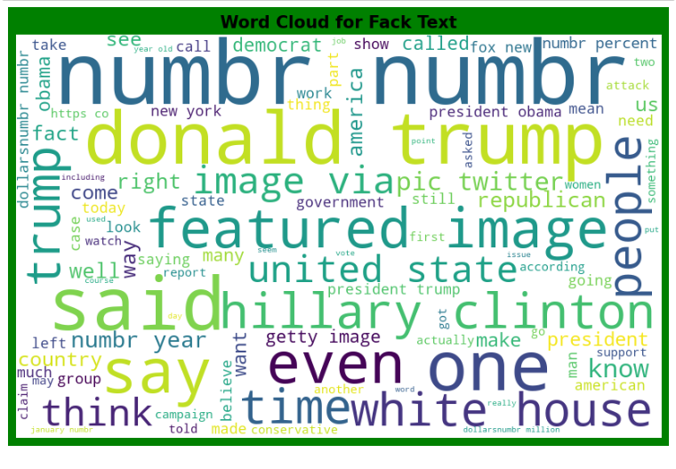
Data Inputs- Logic- Output Relationships
I have analysed the input output logic with word cloud and I have word clouded the sentenced that as classified as foul language in every category.
Key Observations:
We can evidently see that most of the fake news are from "trump", "number', "said", "support" which means these fake news sources are not available.
News without a proper author name is being a fake news.

Slide 13
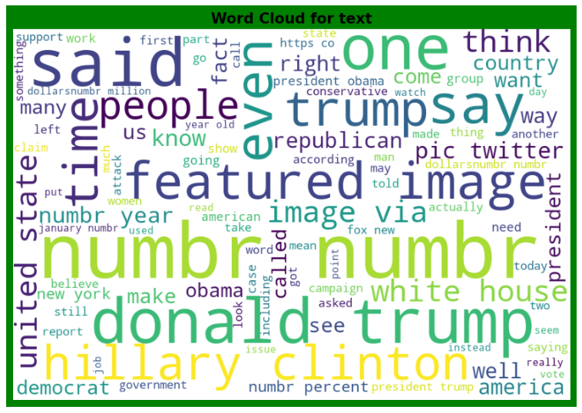
Data Inputs- Logic- Output Relationships
We can see the foul words that are mostly used in Fake News classified sentences we are seeing top 100 words the words which are bigger in size are mostly used.
Key Observations:
Not Fake news have most repeated keywords Well, republican, pic, said which are as same as repeated words in fake new. So, news won’t be much helpfully in our prediction.
And we also see week, job, still, instead, january are being the most repeated words in not Fake news.

Slide 14
Hardware and Software Requirements and Tools Used
Python 3.10
NumPy.
Pandas.
Matplotlib.
Seaborn. 6. Data science.
SciPy
Sklearn.
Anaconda Environment, Jupyter Notebook.

Slide 15
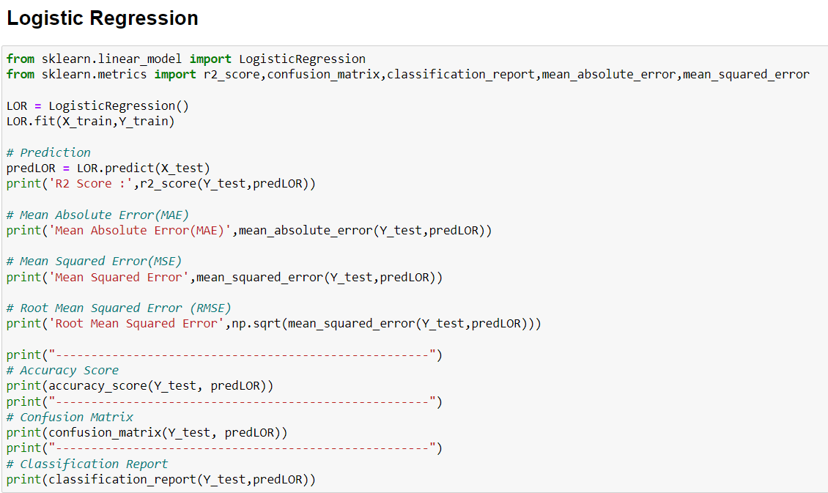
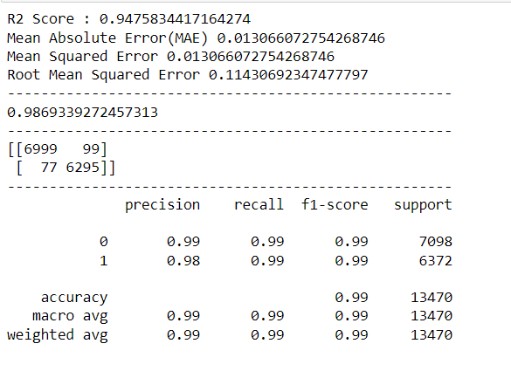
MODEL DEVELOPMENT
After selecting the best random state parameter, I have spitted the data into test and train with test size as 30 %. Again, I have imported the required libraries to import my ML algorithms.

Slide 16
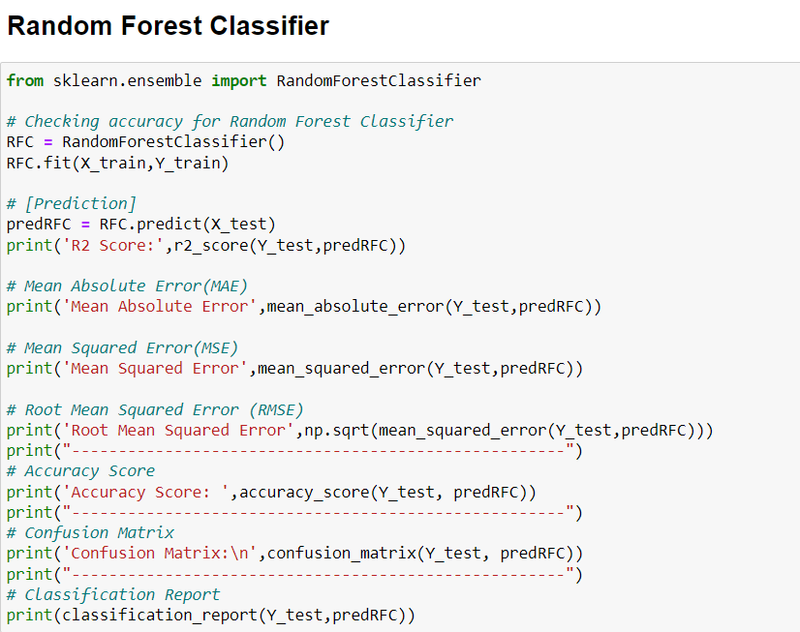
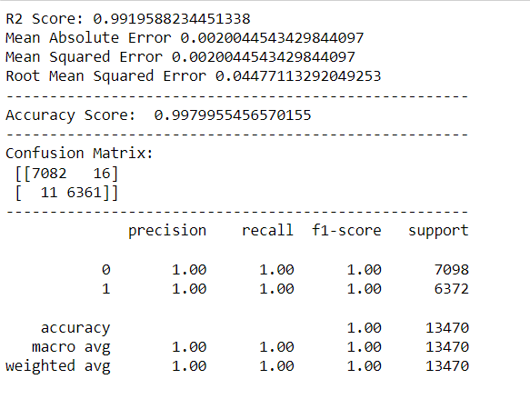

Slide 17
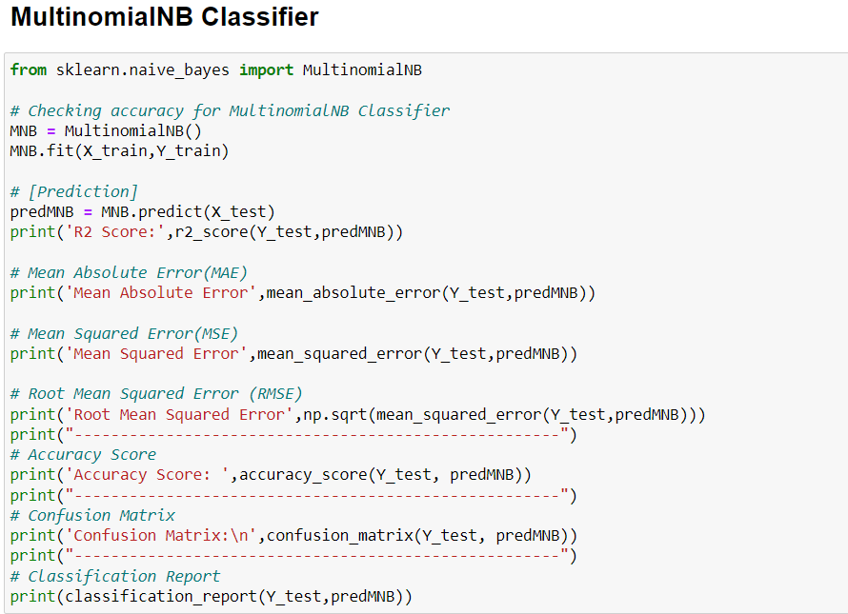
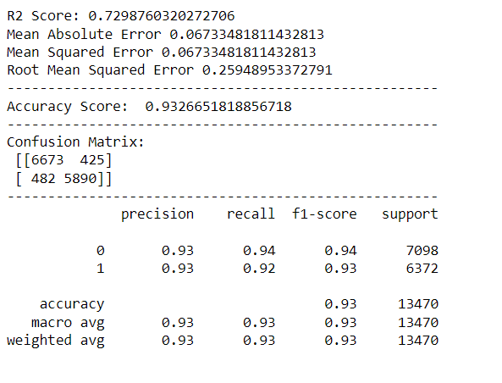

Slide 18
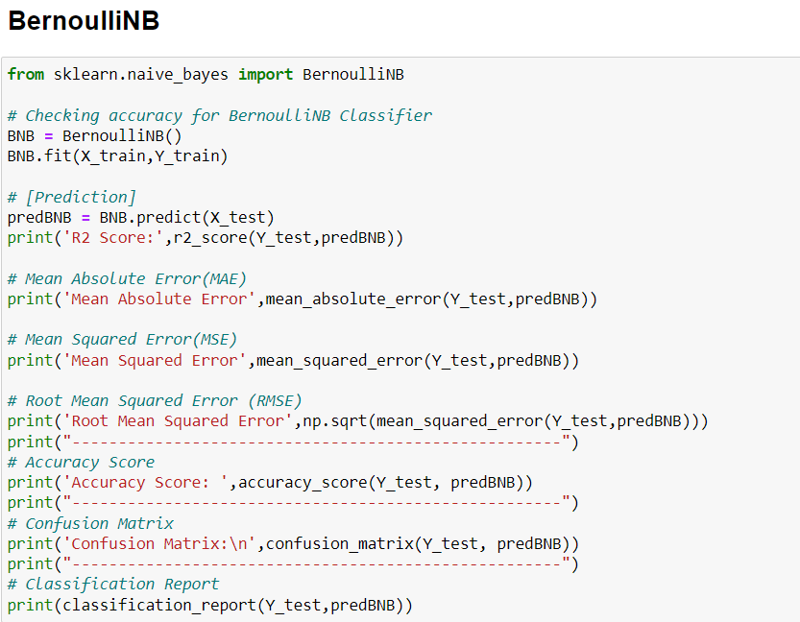
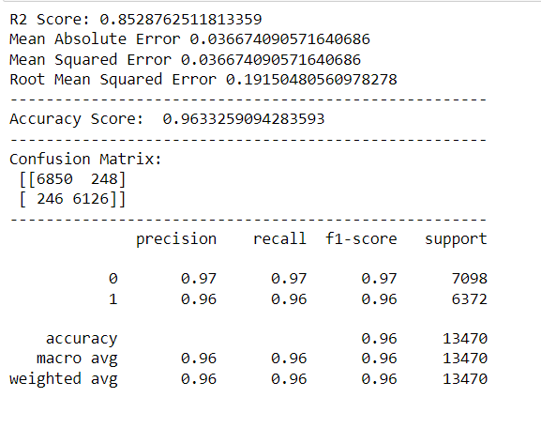

Slide 19
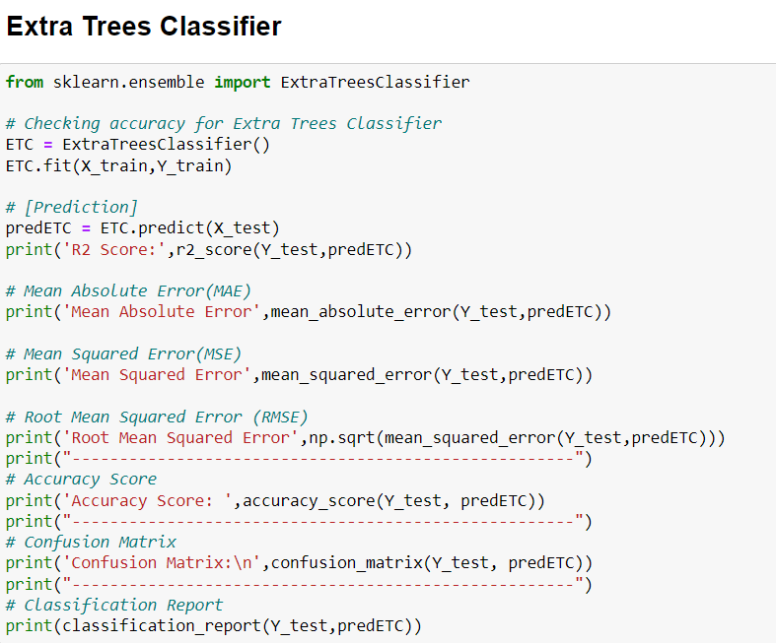
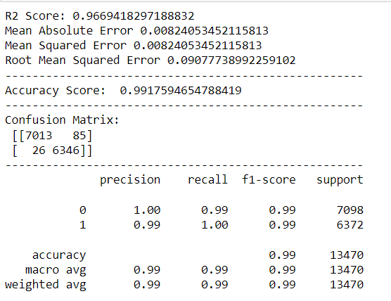

Slide 20
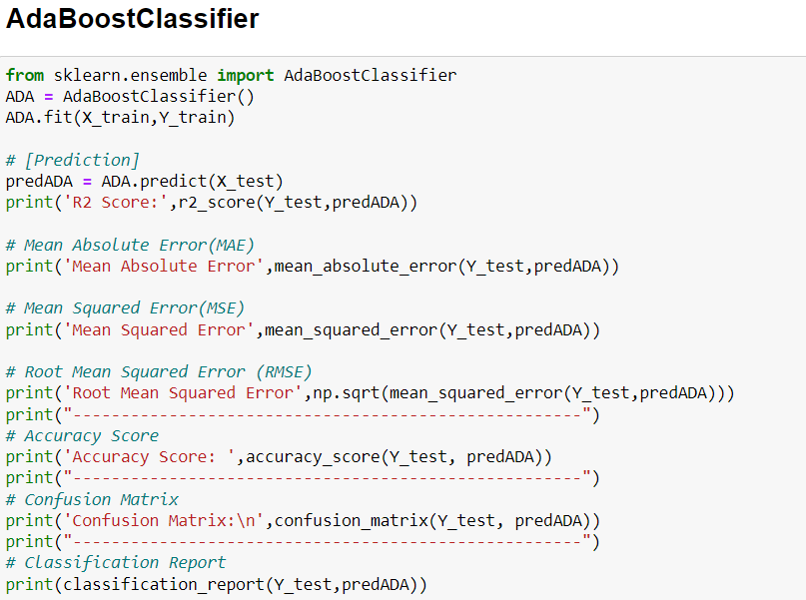
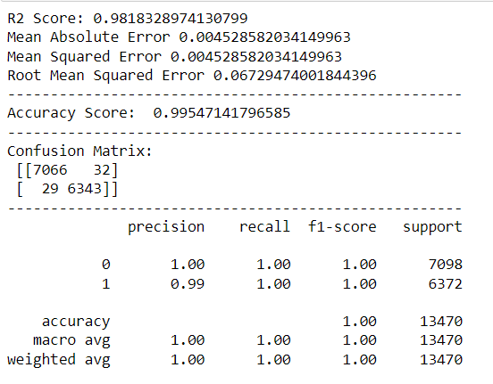

Slide 21
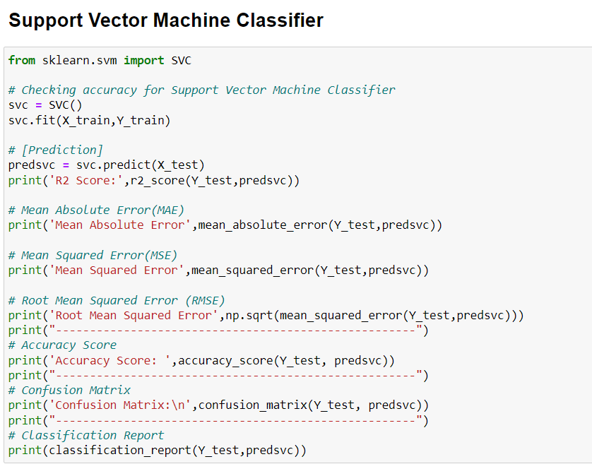
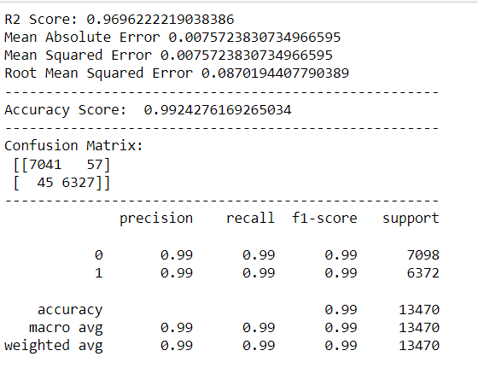

Slide 22
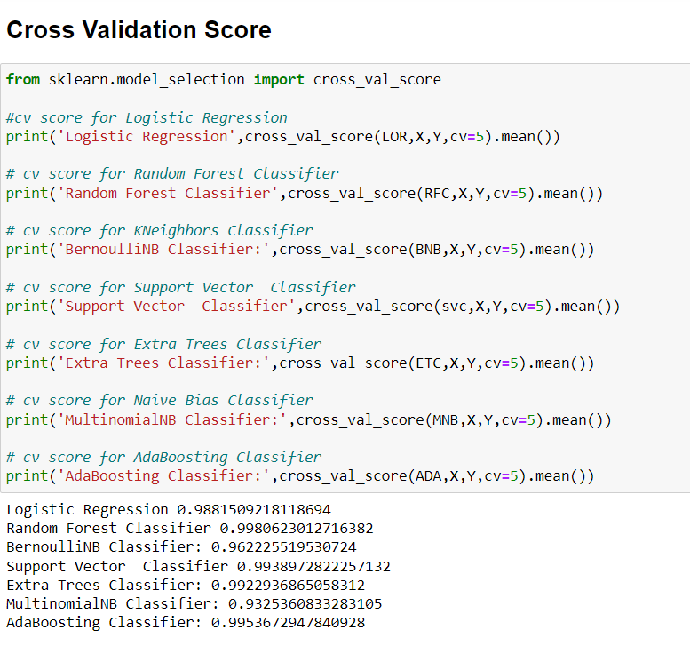

Slide 23
I have taken cross Validation Score to analysis the best model.
As we can see above Random Forest tops the chart, I have selected Random Forest model as my final model and I have Hyper parameter tuned the same to increase the performance of the model and have achieved the accuracy of 99.806 % and I have saved the model.

Slide 24
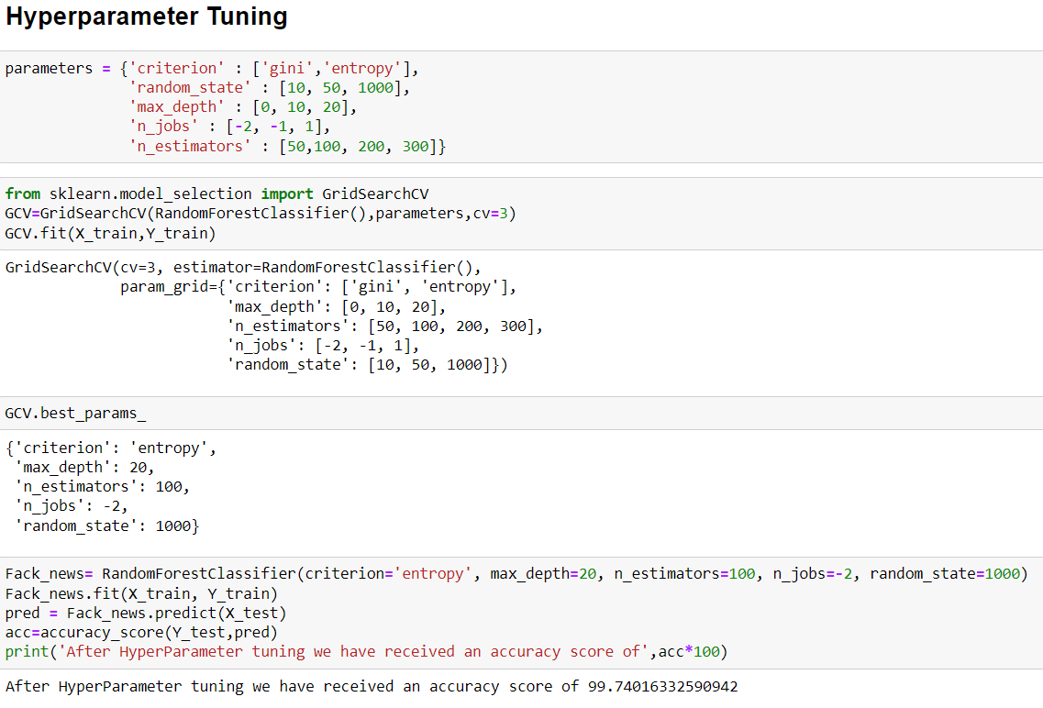
As we can see above Random Forest tops the chart, I have selected Random Forest model as my final model and I have Hyper parameter tuned the same to increase the performance of the model and have achieved the accuracy of 99.740 % and I have saved the model

Slide 25
CONCLUSION
The finding of the study is that when the news’s are being published on a bogus name, the author names not available that news are end up being Fake, and also, we can understand this fake news’s are desperately being spread among the public to create a fake image of an individual, or to get profit out of it or to destroy the good deeds of the target person.
Successfully developed Machine learning model to predict product review ratings.
NLTK library used for text Mining.
Random Forest classifier model is best model with accuracy score of 99.740%.

Slide 26
Thank You

